Slide 1

Green Pace
Security Policy Presentation
Developer: Eric Farkas

Slide 2

OVERVIEW: DEFENSE IN DEPTH
The Defense In Depth model leverages multiple layers of security to protect organizations from attack. This diagram illustrates how these layers overlap and create a mesh of defense to protect data, systems, users, and assets.

Slide 3
THREATS MATRIX
Likely Data Type Data Value String Correctness SQL Injection Memory Protection Polymorphic Object | Priority Data Type Data Value String Correctness SQL Injection Memory Protection Expressions
Low priority Assertions Exceptions Polymorphic Object Integer Precision | Unlikely Assertions Integer Precision
The Threat Matrix is a visualization tool for identifying business risks, threats, and vulnerabilities as part of the risk management program.

Slide 4
10 PRINCIPLES
Validate Input Data
Heed Compiler Warnings
Architect and Design for Security Policies
Keep It Simple
Default Deny
Adhere to the Principle of Least Privilege
Sanitize Data Sent to Other Systems
Practice Defense in Depth
Use Effective Quality Assurance Techniques
Adopt a Secure Coding Standard

Slide 5
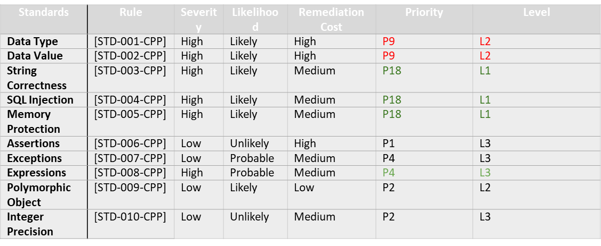
CODING STANDARDS

Slide 6
ENCRYPTION POLICIES
Encryption at rest: We must encrypt data at rest using full-disk and database encryption at the server level while providing a backup strategy.
Encryption in flight: Use the latest, secure libraries, use Public Key infrastructure for end-to-end protection on message bodies or attachments, use Managed File Transfer or SSH with an expiration date on the link, use password access, and utilize Data leak prevention mechanisms built into cloud services.
Encryption in use: Utilize identity management mechanisms to confirm user roles and identities. Allow conditional access to the tools' functionality based on the user roles and other parameters. Use digital rights management to apply persistent protection to documentation.

Slide 7
TRIPLE-A POLICIES
Authentication: The process of identifying a user, using valid credentials for username and password. Maintain control over how a user is authenticated using a secured local database or external server via appropriate secure protocols.
Authorization: After the user has been authenticated, authorization shall be used to determine which resources and functionality the user has permission to access and which operations can be performed.
Accounting - Monitor and log user events while logging in/out or utilizing the resources, user uptime, or other actions of interest.

Slide 8
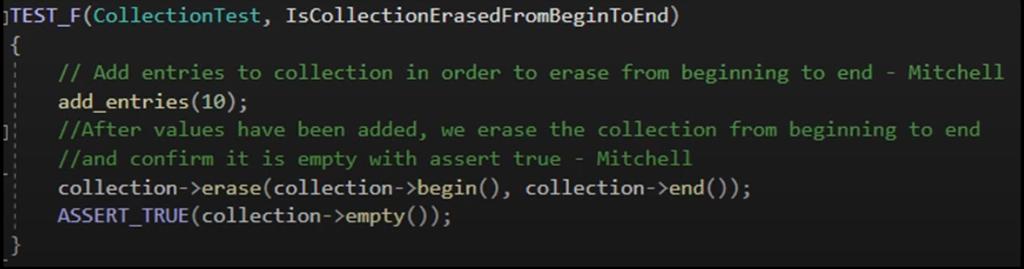
Unit Testing
Assertion Testing: The unit testing below examines Assertions, which are mainly used in unit testing, and how these assertions can help in both testing and ensuring proper data use in other applications. The standard coding label is [STD-006-CPP]

Slide 9
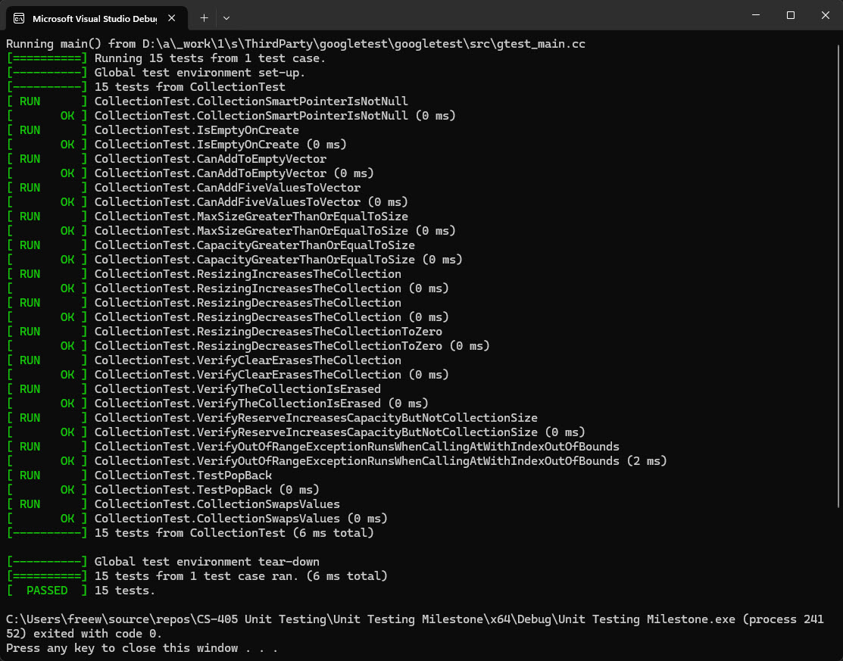
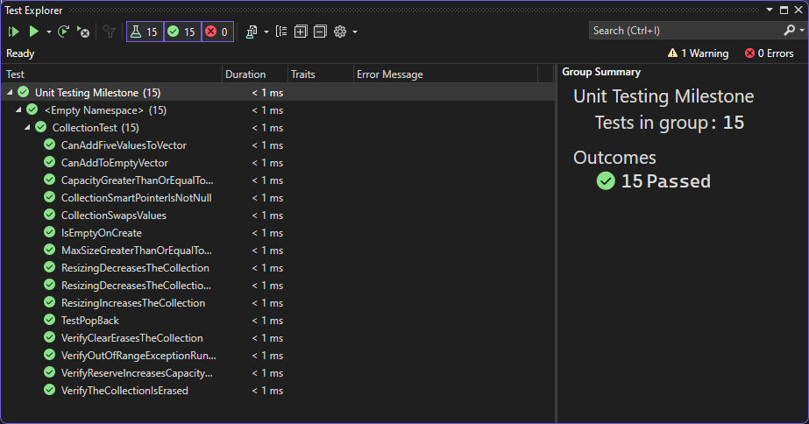
Unit Testing

Slide 10

AUTOMATION SUMMARY

Slide 11
TOOLS
Every software development approach has a pipeline or a series of steps the software goes through during its lifecycle. DevSecOps's steps and stages are mostly automated, prioritize security, and heavily depends on team collaboration.
Parasoft C/C++test: Used during the pre-production design, verify/test stage. Used during the transition/health check and maintain and stabilize stage in post-production.
Intruder: Used during transition and health check stage of post-production to perform penetration testing.
LoadNinja: Used in the verify and test pre-production for stress testing. Used during the maintain and stabilize stage in post-production.

Slide 12
RISKS AND BENEFITS
Benefits
Maintain a positive company reputation
Increased efficiency / Lower development costs
Increased security / Lower downtime & rework
Better alignment with regulatory & compliance standards
Risks
Continual system maintenance / High maintenance cost
User loss / Productivity loss / Revenue loss
Exposure of additional systems

Slide 13
RECOMMENDATIONS
Assess the current policies and compare them to your industry's best practices and requirements. The assessment should cover the scope, content, format, and communication of your policies and their alignment with your company's business objectives and risk appetite.
Identify the gaps between current policies and the desired state. Gaps are typically missing, outdated, conflicting, or poorly implemented policies.
Communicate and provide training on new or updated policies and their justification. Use various channels and formats, such as emails, newsletters, intranet, webinars, or workshops, to disseminate your policies and raise employee awareness. Training and education programs help employees understand and incorporate policies into their daily work

Slide 14
CONCLUSIONS
It is presumptuous to believe systems are completely secure. Leveraging a security policy that remains up to date and features multiple layers of security provides the best chance of thwarting attempts to compromise an organization. Clearly written policy and quality logging protect the organization from accidental compromise by internal resources.
Training developers and users is an important and ongoing task that improves security and makes policies enforceable. New and revised policies should always be communicated to the entire organization. In-depth training should be reserved for positions responsible for implementing them.
Defense-in-depth strategies require regular cross-functional meetings led by a security-minded champion. These strategies are complicated and require a great deal of coordination and testing to ensure they work as expected.

Slide 15
REFERENCES
C++test - Check C++ and C Code for Compliance. Parasoft. (2021, June 7). https://www.parasoft.com/products/parasoft-c-ctest
Create and Run Load Tests in Half the Time. LoadNinja.(n.d.). https://loadninja.com/resources/
Log Management & Analysis Software Made Easy. Logentries. (n.d.). https://www.rapid7.com/products/insightidr/use-cases/
Tasnim, R. (n.d.). What Is Unit Testing? Softwaretestingstuff. Retrieved June 17, 2024, from https://www.softwaretestingstuff.com/c-unit-testing

